Slide 1
Updated Greenhouse Gas Emission Reduction Targets
City of Piedmont

Slide 2
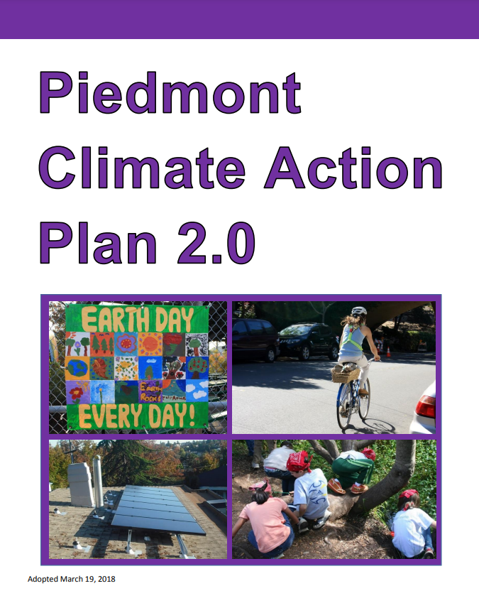
Climate Action Plan 2.0
Current Greenhouse Gas Emissions Goals
Reduce in-territory greenhouse gas emissions*:
40% below 2005 levels by 2030
80% below 2005 levels by 2050
*CAP 2.0 goals no longer aligned with current state, federal, and global targets; staff are proposing updated targets in tonight’s meeting

Slide 3
Piedmont’s GHG Emissions Trends

Slide 4
Global, National, State, & Local Context
Paris Agreement set goal of reducing emissions to keep global surface temperature rise in this century below 1.5 degrees Celsius*
Biden Administration aims to achieve a 50-52% reduction from 2005 levels by 2030; net zero emissions no later than 2050
California aims to achieve net zero emissions no later than 2045
Locally, 9 cities in Alameda County have committed to net zero emissions by 2045
*To date, the release of anthropogenic GHG emissions is estimated to have caused the global surface temperature to increase approximately 1.1 degrees Celsius (1.8 degrees Fahrenheit) above pre-industrial levels.
Source: Intergovernmental Panel on Climate Change. Sixth Assessment Report. Synthesis Report. 2023.

Slide 5
Proposed New Emission Reduction Goals

Slide 6
Piedmont’s GHG Emissions by Sector (Metric Tons of Carbon Dioxide Equivalent) and Reductions Needed to Meet New Proposed Goals
 | 2005 | 2010 | 2015 | 2021 | 2030 Goal | 2045 Goal
Buildings & Energy Use | 25,573 | 24,974 | 19,176 | 15,551 | 12,786 | 0
Transportation | 20,210 | 20,053 | 18,102 | 15,902 | 10,105 | 0
Solid Waste | 2,620 | 1,454 | 1,128 | 276 | 1,309* | 0
Water & Wastewater | 415 | 420 | 86 | 142 | 207* | 0
Fugitive Emissions | -- | -- | -- | 486 | 0 | 0
Total Emissions | 48,818 | 46,901 | 38,492 | 32,357 | 24,409 | 0
*Solid waste and waste & wastewater sector emissions have already met 2030 goals based on the latest completed inventory for calendar year 2021.

Slide 7
2021 GHG Emissions Inventory Topline
Since 2005… 34%
Since 2018… 6%
2019… 5%
2020… 3%

Slide 8
2021 Community GHG Emissions
Summary:
Buildings: 49%
Transportation: 48%
Fugitive: 1.5%
Solid Waste: 1%
Water: <1%

Slide 9
Conclusions
Piedmont is close to meeting its 2030 emissions reduction goal, but at the current pace it will not meet future goals without significant effort.
Natural gas and transportation remain the primary sources of emissions, the levels of which are stagnant or increasing.
Reductions must be centered on decarbonization efforts (e.g., shift to electric vehicles and electric appliances) in combination with lifestyle changes to address consumption.

Slide 10
Programs to Help Meet Emission Goals
CAP Implementation
Building Electrification Program
EVs and Active Transportation Program
Organics and Recycling Program
Sustainability Outreach and Education

Slide 11
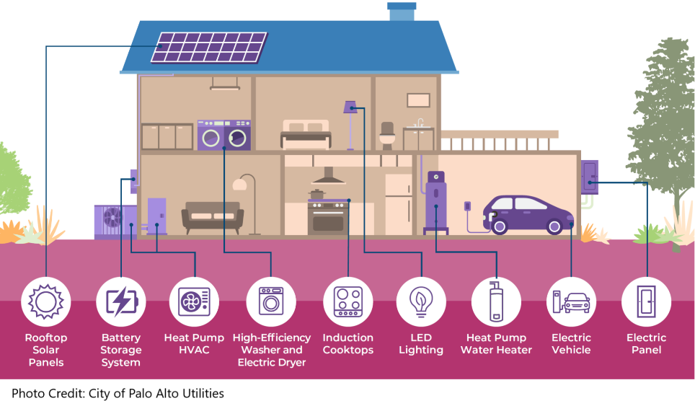
Building Electrification
Future Initiatives
Building Electrification Task Force
Existing Buildings Electrification Strategy
Solar/Battery Storage at Municipal Facilities
Streamlined Solar Permitting
Ongoing Initiatives
All-Electric Aquatic Facility
Electrification Rebate Program
Home Energy Assessment Policies
Induction Cooktop Lending Program
Municipal Energy Portfolio Audit
Renewable Electricity Enrollment
Renewable Energy Generation
Reach Codes

Slide 12
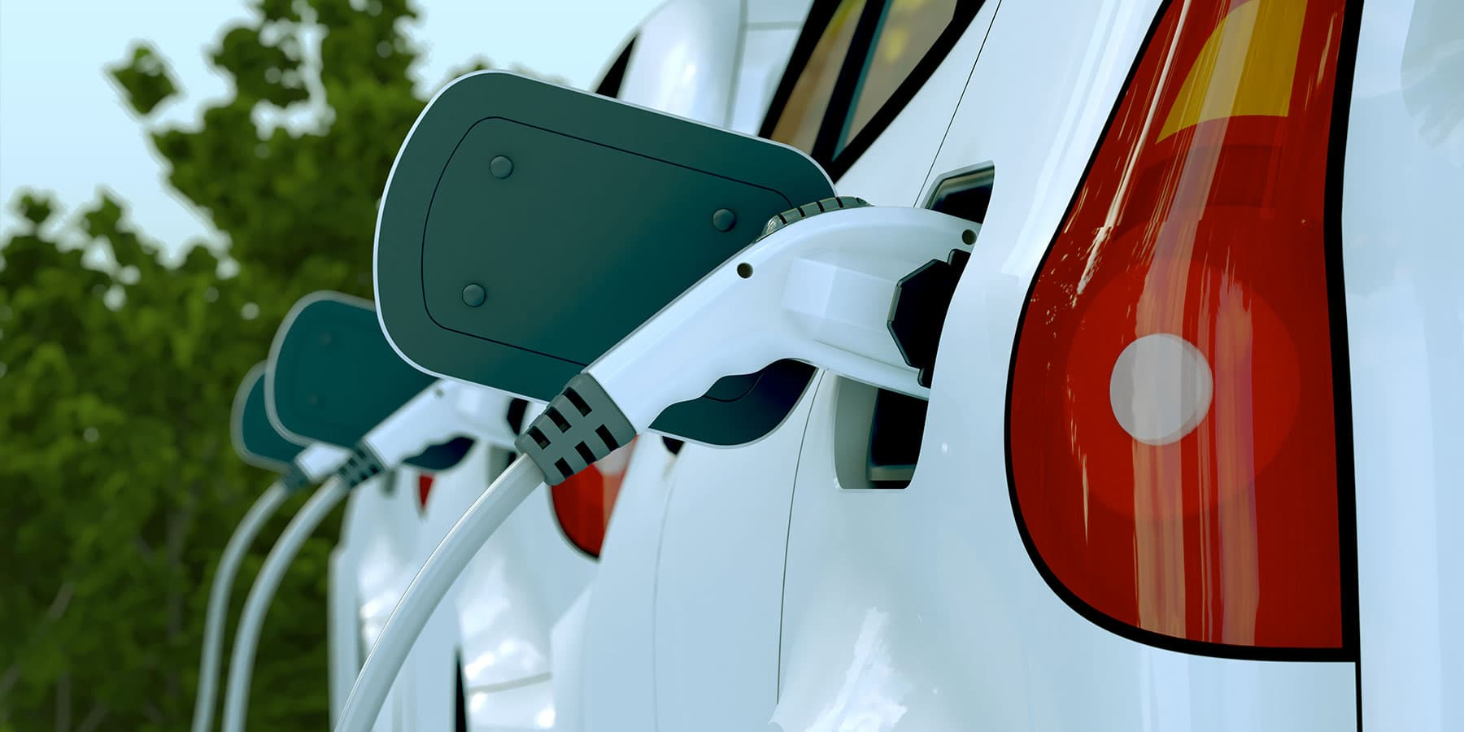
EVs and Active Transportation
Future Initiatives
Exploring feasibility of a micromobility program
Encouraging telecommuting policies
Encouraging land use decisions that increase work-live and mixed zoning
Increasing mode shifts to active and public transportation
Ongoing Initiatives
Installation of high priority bike-pedestrian improvements
Municipal Fleet Electrification Assessment
Municipal Fleet Charging Stations
Public EV Charging Stations
Retirement of gas and diesel-fueled vehicles and adopting electric vehicles
Streamlined EV Charger Permitting
Photo Credit: EBCE

Slide 13
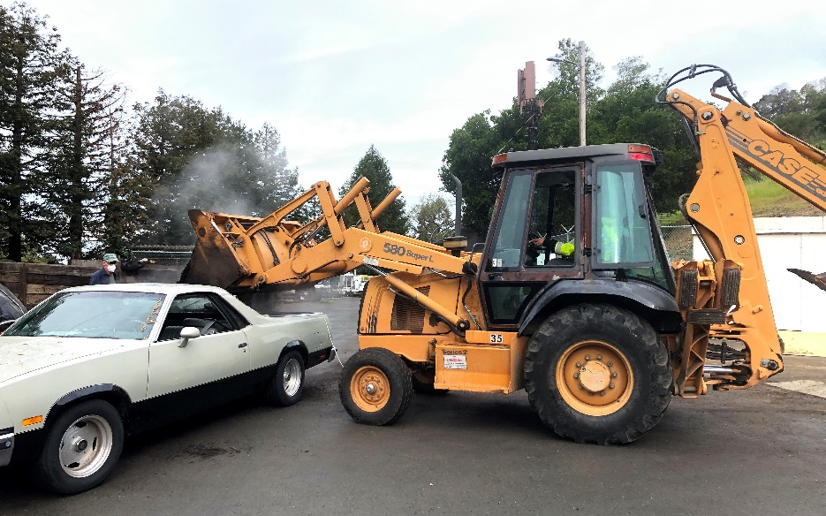
Organics, Recycling, and Consumption
Future Initiatives
Exploring the feasibility of a reusable food ware policy
Encouraging creation of community gardens
Partnering with PUSD to reduce emissions from consumption of goods/food
Ongoing Initiatives
Free Compost Giveaway Program
Implementation of Sustainable Purchasing Policy
Installation of 3-series bins in parks and public spaces
Installation of public drinking water stations
Piedmont Evergreen event technical assistance
Senate Bill 1383 implementation and participation in curbside organics collection services

Slide 14
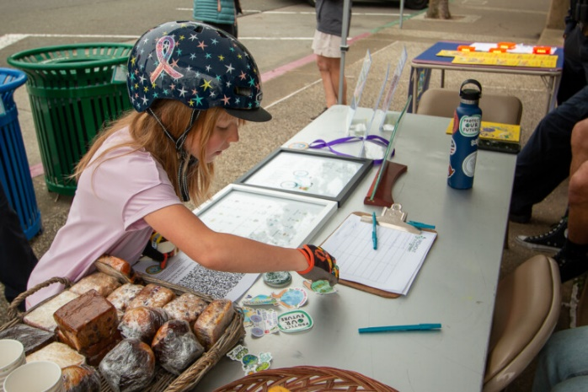
Outreach and Education
Future Initiatives
Exploring feasibility for a Community Resilience Hub
Exploring feasibility for developing a Sustainable Parks Master Plan
Launch of Youth Climate Ambassador Program
Ongoing Initiatives
Bike to Work Day
Collaboration with PHS Green Club
Collaboration with local community groups
Continuing participation in Climate Corps Fellowship Program
Development of Climate Communications Plan
Earth Day/Month Events
Monthly Climate Action e-newsletter
Piedmont Community Climate Challenge
Piedmont Post ‘Climate Corner’
Photo Credit: Julie Reichle, Piedmont Exedra

Slide 15
Contact
Alyssa Dykman
Sustainability Program Manager
adykman@piedmont.ca.gov
Sophie Roberts
Climate Action Fellow
sroberts@piedmont.ca.gov

